Slide 1
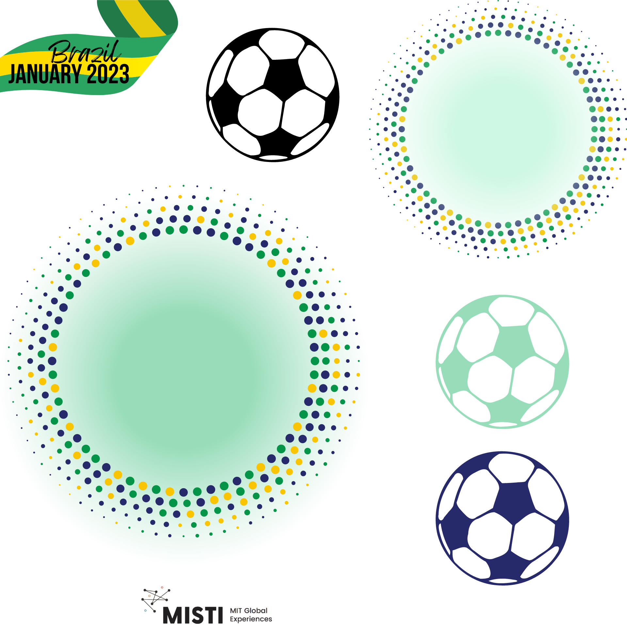
Soccer Ball (materials) Science
Camp Overview
January 2023

Slide 2
GOOOOOAL
What are the big ideas of the week?
Learn about all the polymers in soccer (and many other places, too)
Conduct experiments
Apply what you learn to give sustainability advice
Play soccer and have fun!

Slide 3
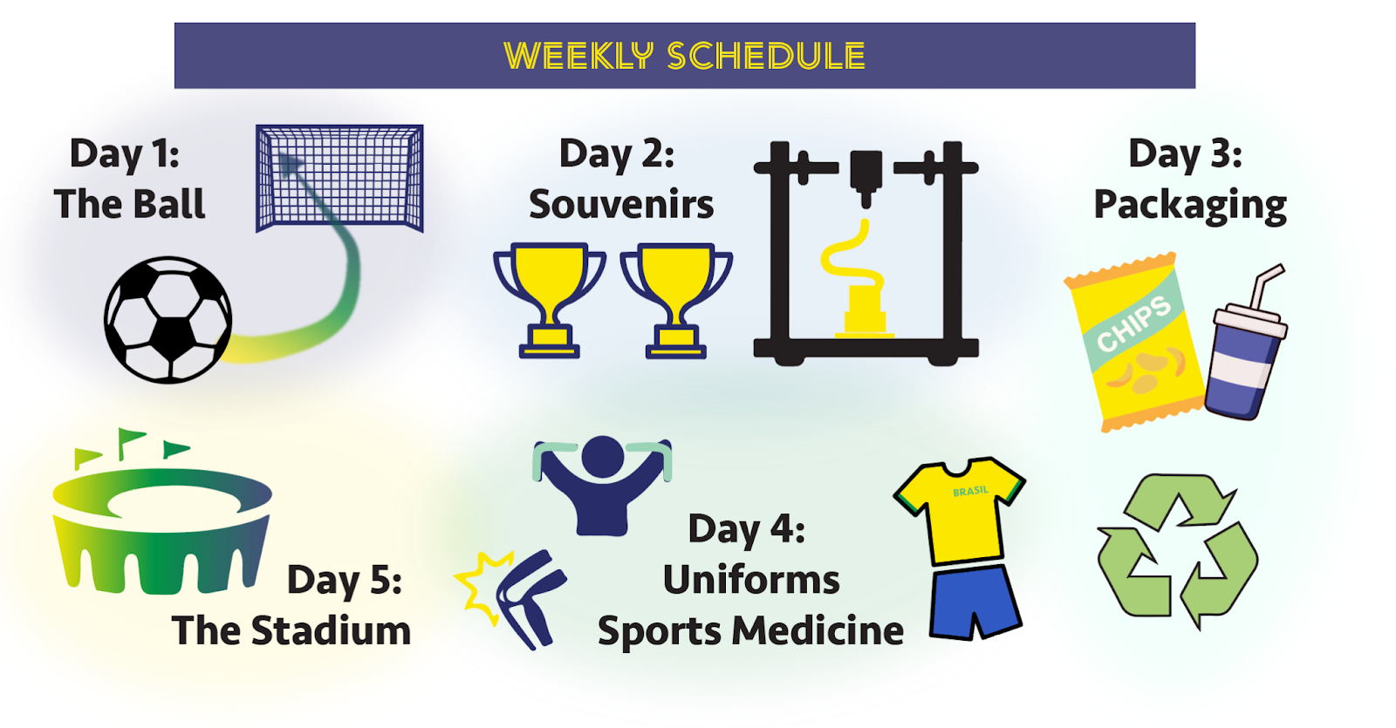

Daily themes

Slide 4
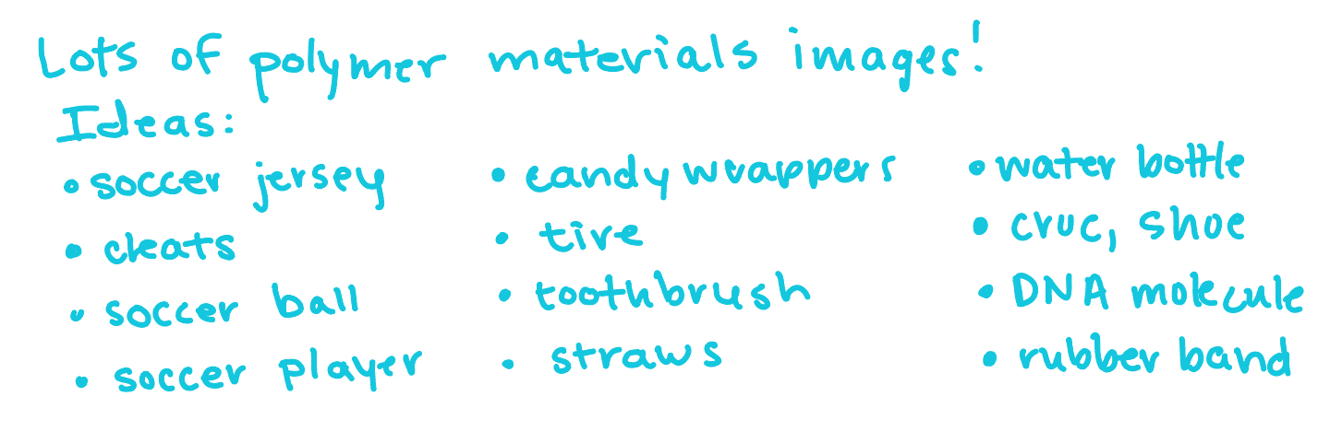
Why study polymer materials?
Because they are everywhere!

